Slide 1
2023 Case Study For Cyclistic Bike
HOW DOES A BIKE-SHARE NAVIGATE SPEEDY SUCCESS?

Slide 2
The Company and Business Task
Company
Business Task
In 2016, Cyclistic launched a successful bike-share offering. Since then, the program has grown to a fleet of 5,824 bicycles that are tracked and locked into a network of 692 stations across Chicago. The bikes can be unlocked from one station and returned to any other station in the system at anytime.
Analysing how casual riders and annual members use cyclistic bikes differently, using this insight to Design a new marketing strategy that is aimed at converting casual riders into annual members. Thereby Maximizing the number of annual memberships.

Slide 3
The team
Cyclistic Executive
Team
Dir. of Marketing
Lily Moreno
Cyclistic Marketing
Analytics Team

Slide 4
A description of all data sources used.
The data is collected by observation and is a third-party data located online, in a CSV file format, the data is reliable but not original, comprehensive, current and not cited.

Slide 5
Documentation of cleaning and manipulation of data.

Slide 6
Sorted the sheet using first column. Filtered each datasheet to check for blank spaces, and whitespaces, remove duplicates, check spellings.
Added 2 new columns (ride_length and day_of_week). Changed the data format for column day_of_week to number, column ride_length to time and changed the data format for columns start_date_time and end_date_time to date and time.
Column day_of_week is for calculating the day of the week that each ride started using the “WEEKDAY” command and formatted as general or as a number with no decimals, noting that 1 = Sunday and 7 = Saturday.
1
2
3
4
5
Checked column ride_id length and removed ride_id that is not equal to the average length.
Renamed columns to be more descriptive: ride_id to trip_id, rideable_type to bikeid and casual_member to usertype, and hid start_date_time, start_station_name, end_date_time, end_station_name.
Column ride_length is for calculating the length of each ride by subtracting column end_date_time from column start_date_time.

Slide 7
A summary of analysis
Conducted a few descriptive analyses on each month for the last 13 months 01/2022-01/2023 to calculate:
Mean and Maximum of ride length for all users.
Mode of day of week.
Average ride length for members and casual riders.
Average ride length for users by day of week.
Counted the number of rides for users by day of week and trip id.
Then I merged them into a summary file to get a year view.

Slide 8
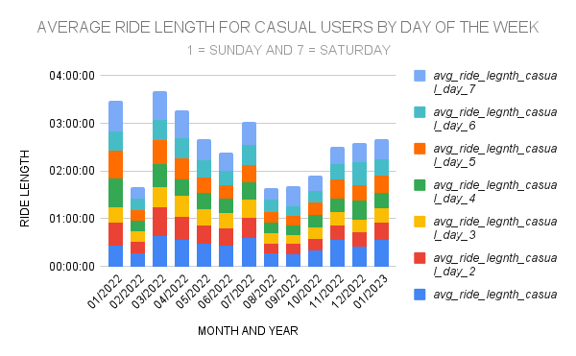
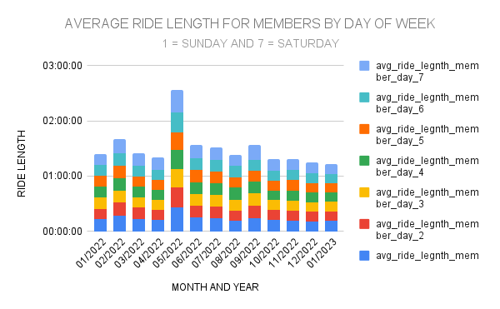
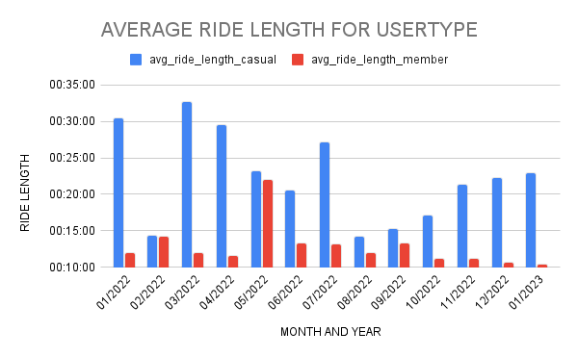
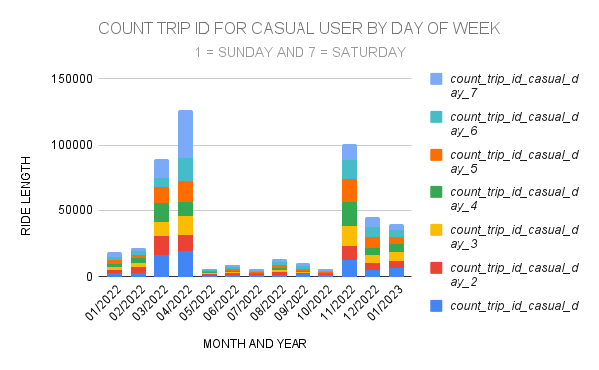
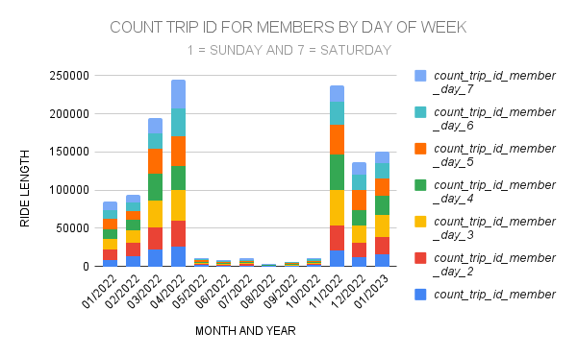

Slide 9
Top three recommendations based on analysis
Similarly, more attention should be given to May 2022 as Day 1 of May 2022 has the highest ride length for casual users by day of the week, which is 00:25:43.
Lastly, it's worth noting that the minimum and average ride length for all users was in January 2023, at 00:10:22 - 00:13:00 respectively.
I suggest focusing more on March as the maximum average ride length for casual users is in March 2022, at 00:32:38 minutes.
Additionally, Day 1 of March 2022 has the highest casual users' ride length by day of the week, at 00:38:48.
m growth

